Slide 1
KTMV high-octane additive

Slide 2
Our organization produces KTMV (high-octane component of motor fuel) for use in the production of motor gasoline with octane number of 92, 95.
In accordance with GOST 12.1.007-76 the KTMV belongs to the 3rd class of hazard. Customs Commodity Code is 271019

Slide 3
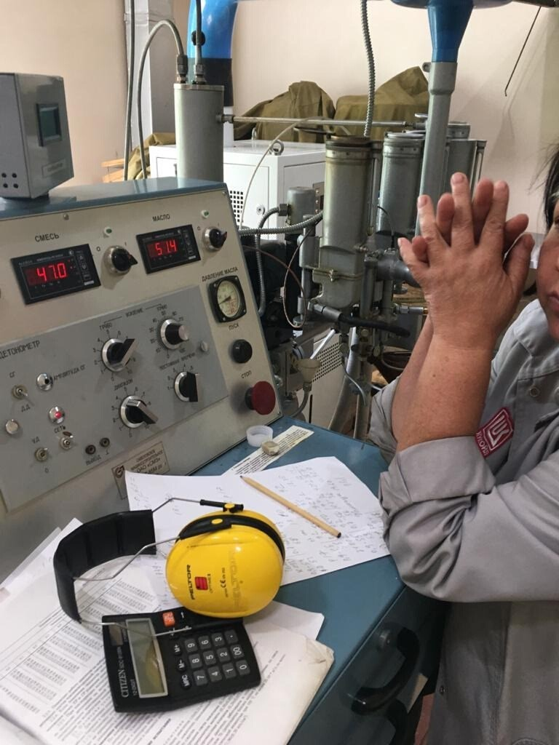
Depending on the initial gasoline, the use of KTMV in production varies from 10% to 15% in volume terms or 3% for AI-95.
The additive has a "gasoline" odor and color characteristic of motor gasoline when blended.
It does not contain MMA and metals.

Slide 4
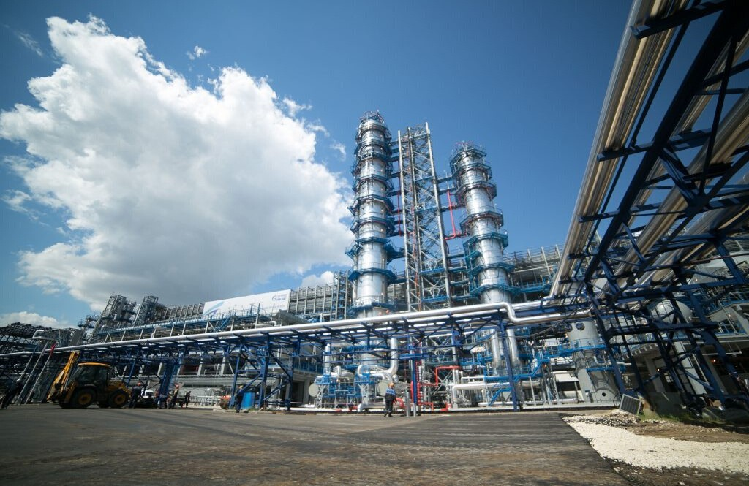
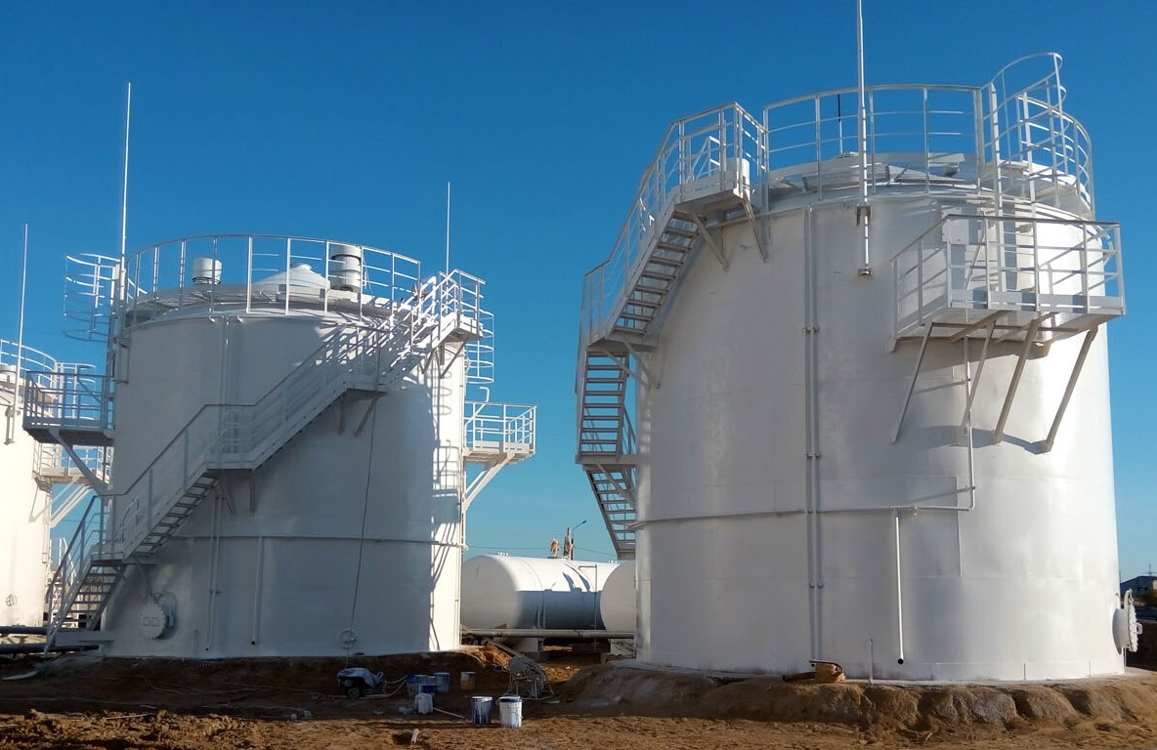
For blending, any tanks available at a typical oil depot and in which it is possible to circulate the combined components of gasoline are suitable.
Solubility in gasoline is complete, without any precipitation.

Slide 5
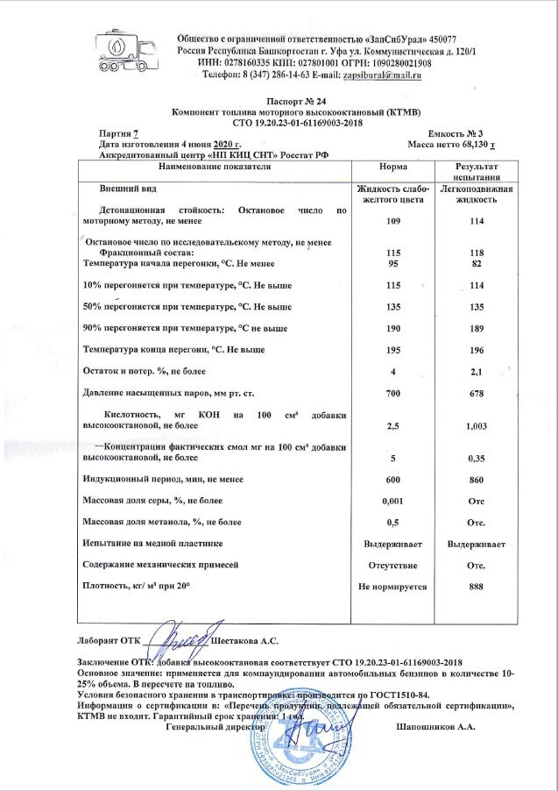
After mixing with gasoline, there is no any stratification and the period of use fully complies with GOST 32513-2013

Slide 6
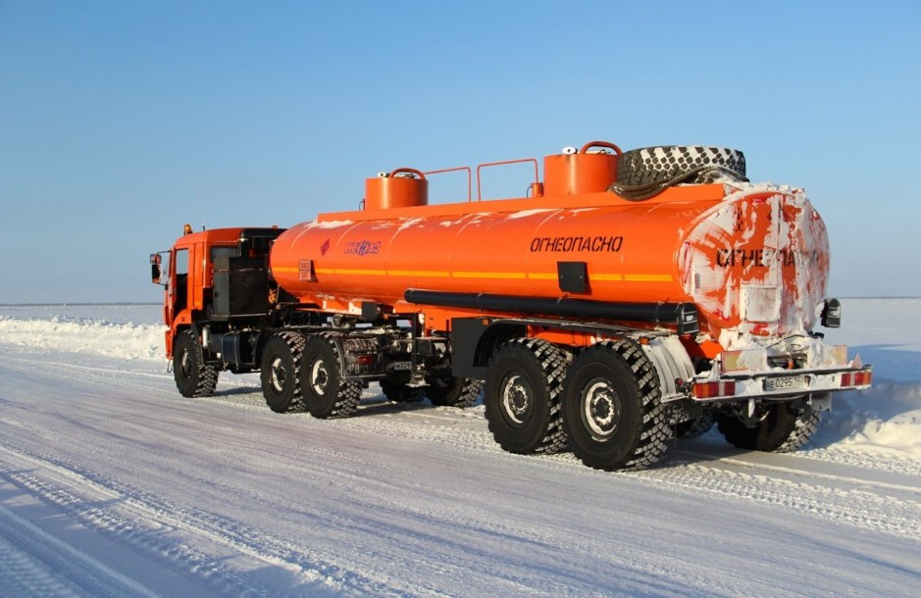
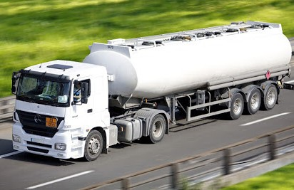
It is not soluble in water. It does not absorb water. It is suitable for use in the weather temperature range from -55 to +55 Celsius.

Slide 7
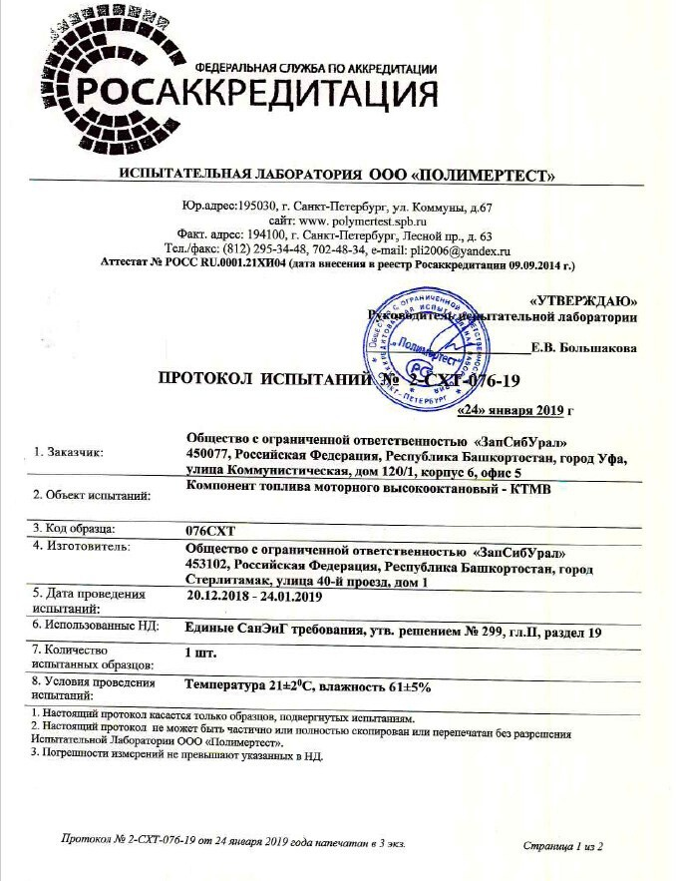
KTMV high-octane additive has accreditation in the Rosakkreditatsiya Federal Accreditation Service

Slide 8
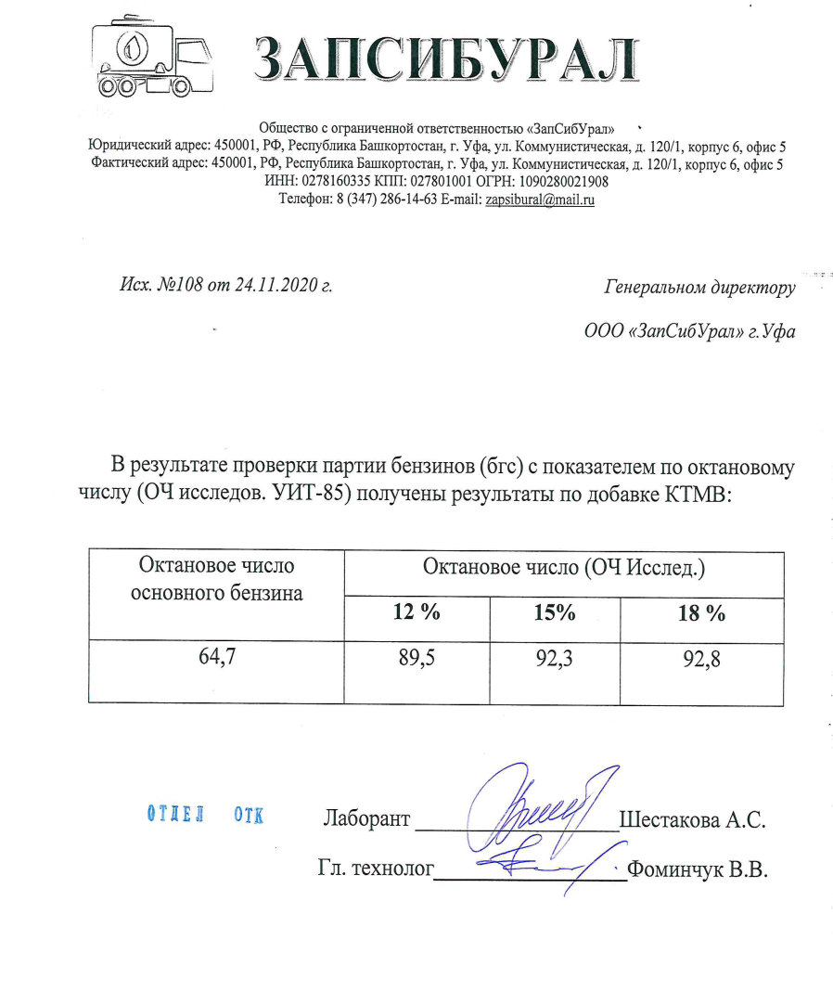
The KTMV high-octane additive offered to your attention allows you to solve any tasks and needs of the customer, regardless of the initial characteristics and quality of the source fuel.
The shown research results clearly show how, with an initially low octane number of the starting fuel - 64.7, by using our additive in various proportions, the octane number of the fuel is increased to 89.5-92.8.
We can also additionally calculate for you the required amount of high-octane additive KTMV, if you provide us with data on the initial fuel quality and the required You are interested in the characteristics of the final product!

Slide 9
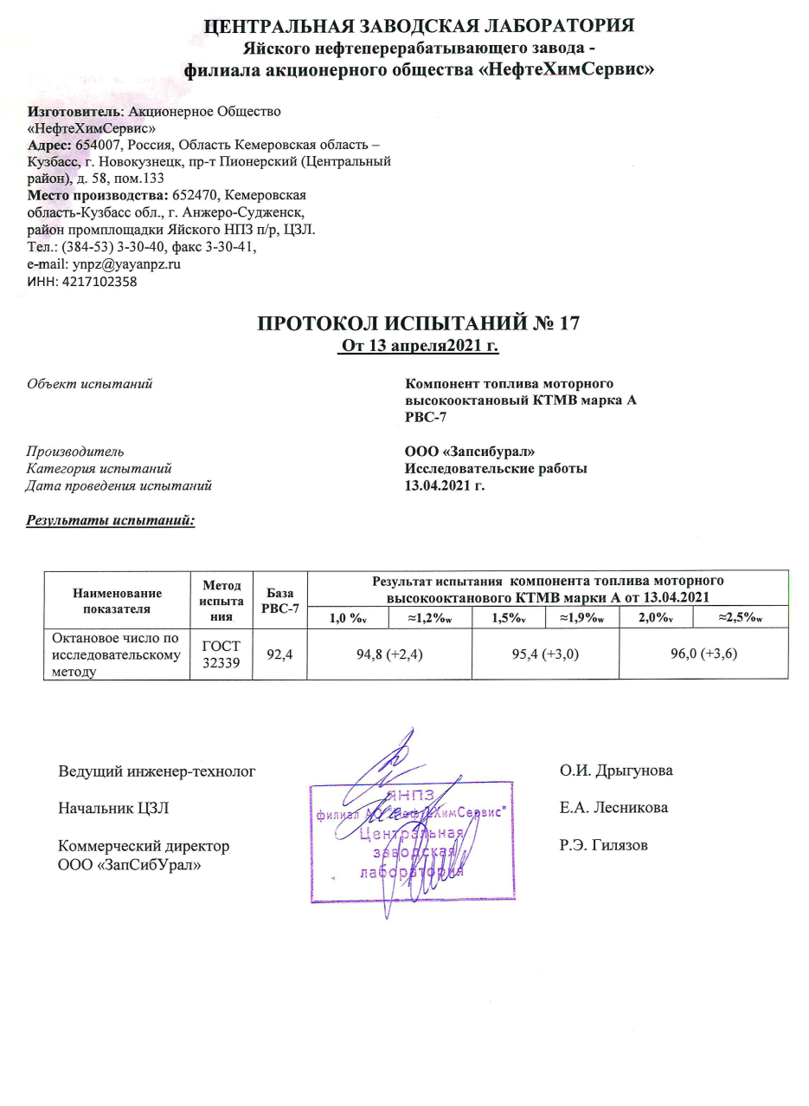
In this example, the customer's fuel initially had a fairly high octane number - 92.4.
However, the customer should increase it by making the fuel better. with the use of the high-octane additive KTMV, the octane number of the analyzed fuel was increased to the values required by the customer, at the same time, we draw your attention to the fact that in order to achieve the required values of 94.8-96, it required the use of insignificant amounts of the high-octane additive KTMV, which also confirms the effectiveness of its application.
Below are more detailed results of studies of the fuel sample in question.

Slide 10
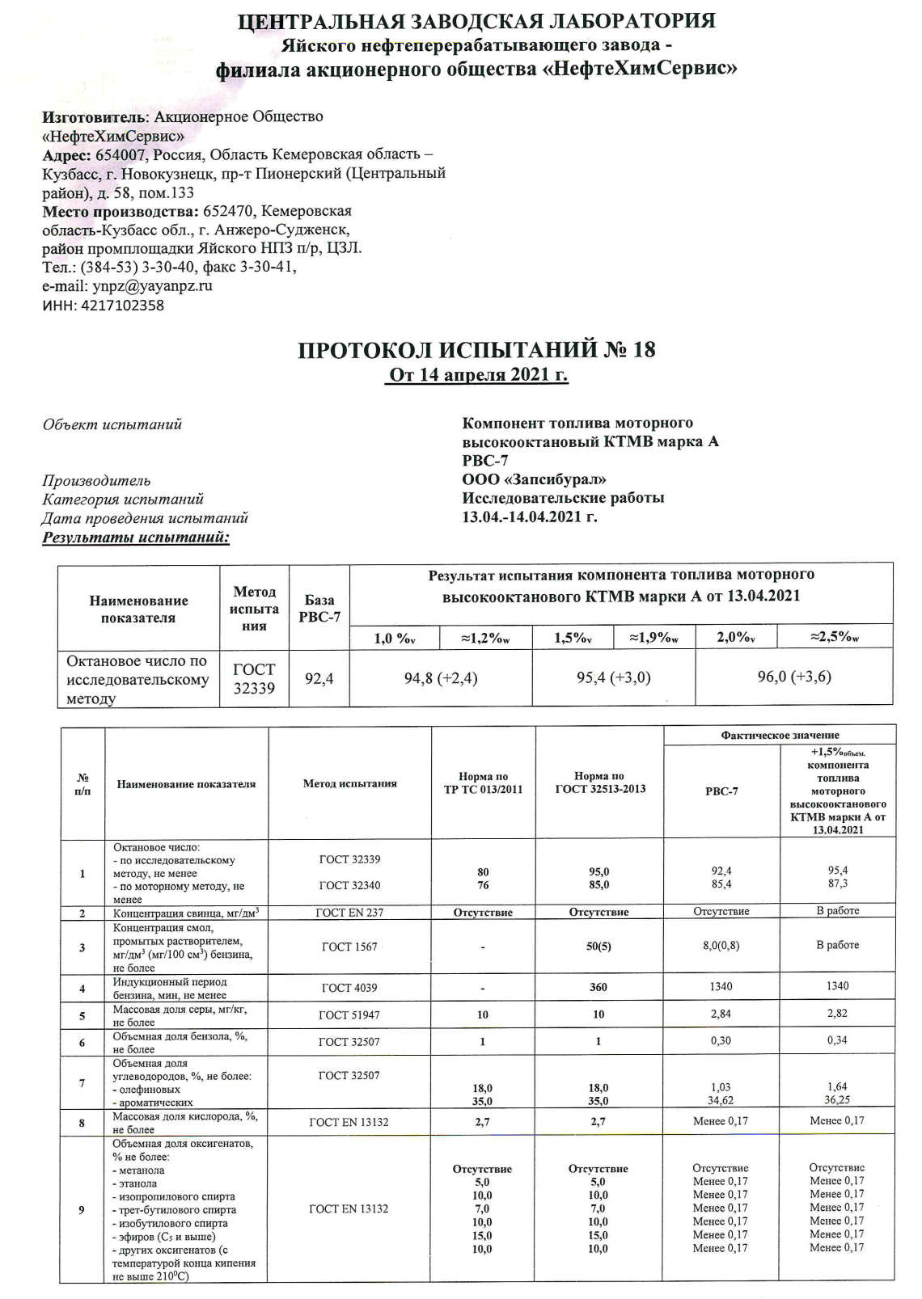
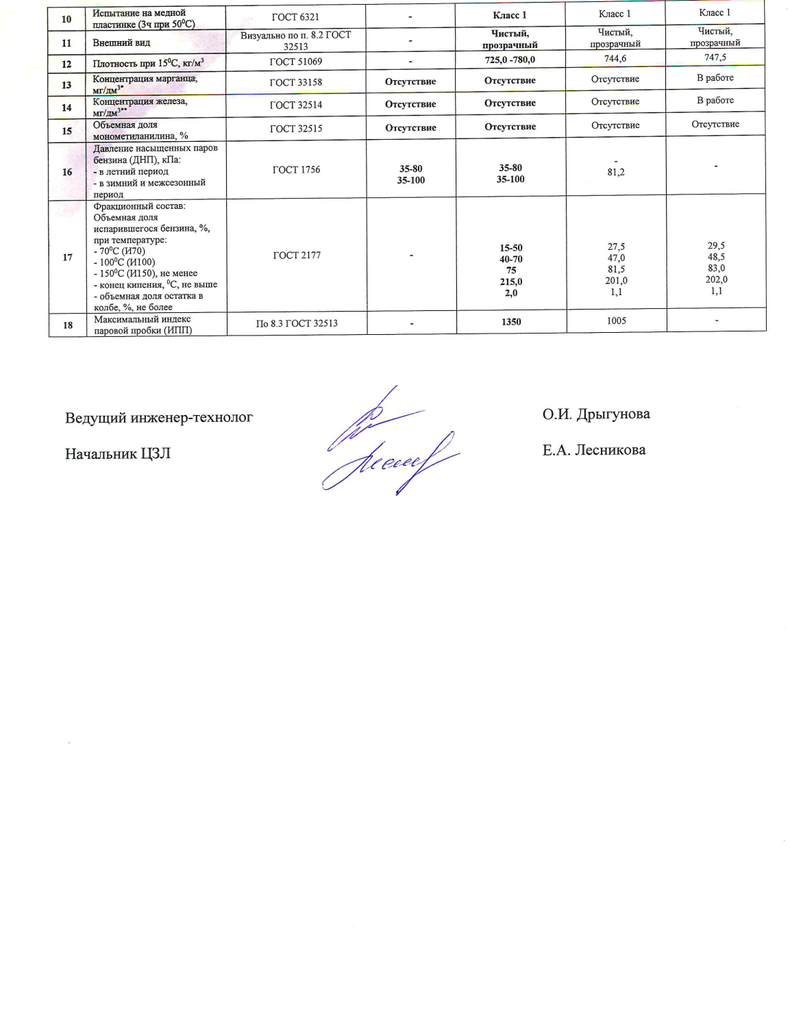

Slide 11
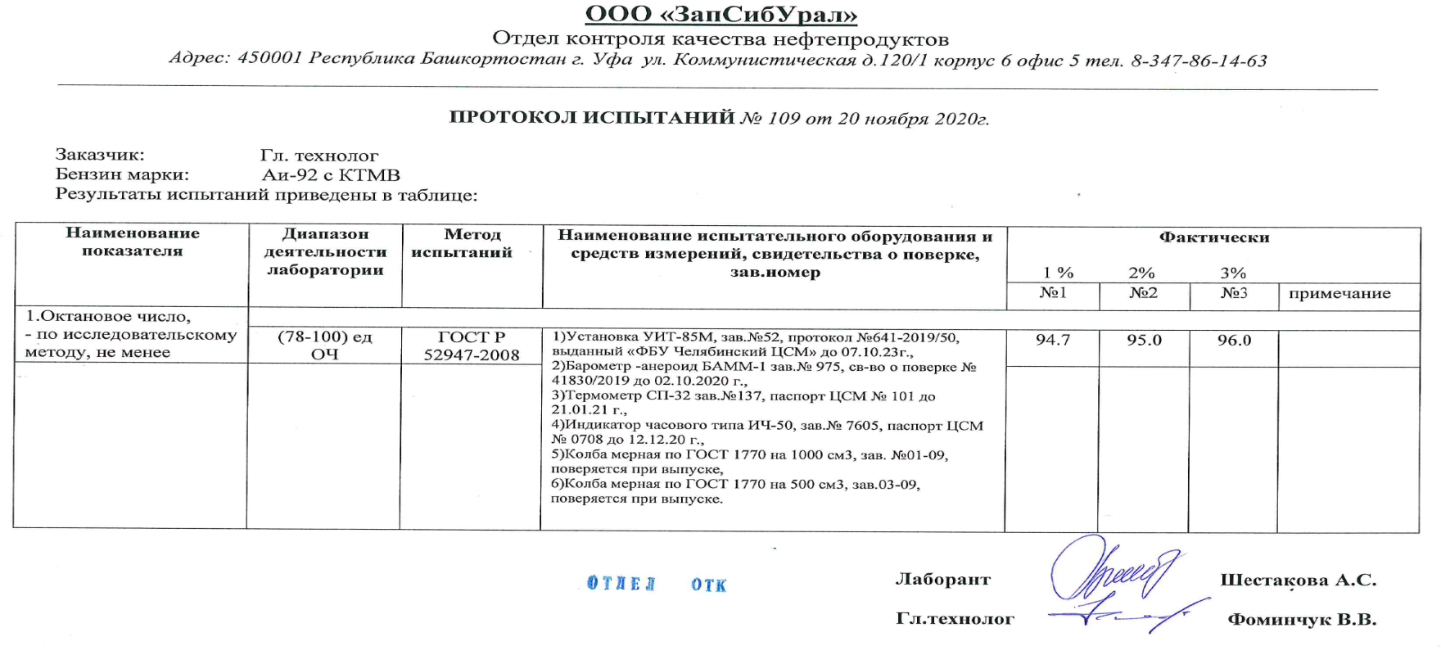
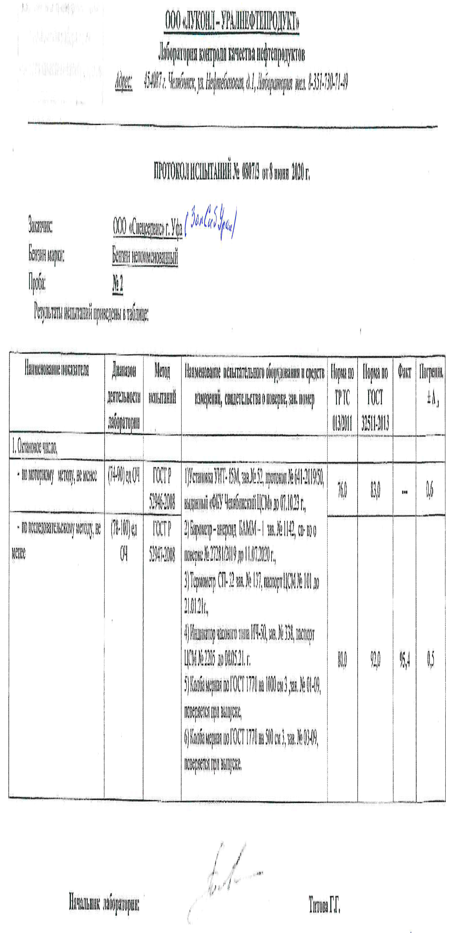

Slide 12
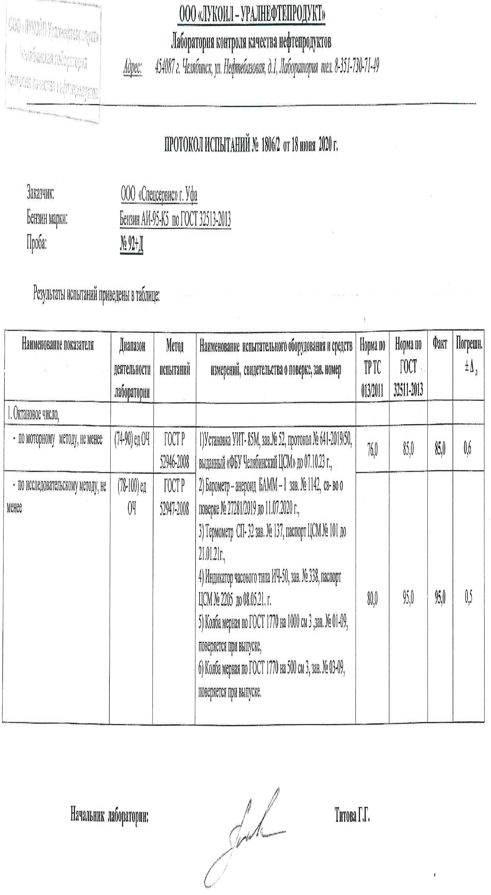

Slide 13
Products are shipped to consumers in rail tank cars or tank trucks suitable for transportation of any gasoline.

Slide 14
OUR DETAILS
ZapSibUral Limited Liability Company
Registered address: 450077 the Russian Federation, the Republic of Bashkortostan, Ufa, 120/1 Kommunisticheskaya Str., Building 6, Office 5
Business address: 450077 the Russian Federation, the Republic of Bashkortostan, Ufa, 120/1 Kommunisticheskaya Str., Building 6, Office 5
TIN: 0278160335
KPP: 027801001
PSRN: 1090280021908
Office phone number: 8 (347) 286-14-63 E-mail: zapsibural@mail.ru

